Slide 1

RESTFUL API WITH ASP.NET CORE
Bhrugen Patel
www.bhrugen.com
Notes:
© Copyright Showeet.com – Creative & Free PowerPoint Templates

Slide 2


What is an API?
API is the acronym for Application Programming Interface, which is a software intermediary that allows two applications to talk to each other.
Request
Response
Client
Server
Notes:
© Copyright Showeet.com – Creative & Free PowerPoint Templates

Slide 3



API Simplified
Request / Order
Response / Cooked Food
Restaurant Table
Chef
Notes:
© Copyright Showeet.com – Creative & Free PowerPoint Templates

Slide 4

API Simplified
Request / Order
Response / Cooked Food
Restaurant Table
Chef
Notes:
© Copyright Showeet.com – Creative & Free PowerPoint Templates

Slide 5

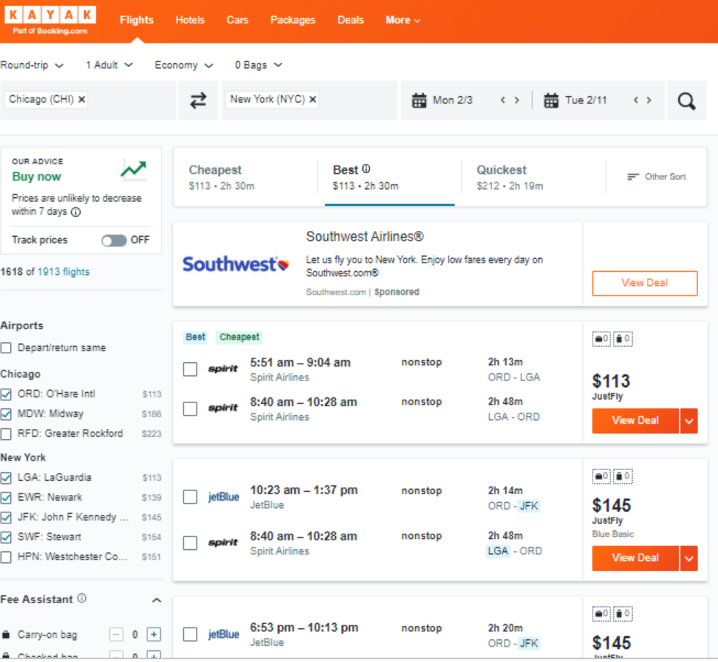


How API works?
API
API
API
Notes:
© Copyright Showeet.com – Creative & Free PowerPoint Templates

Slide 6
HTTP OVERVIEW
Notes:
© Copyright Showeet.com – Creative & Free PowerPoint Templates

Slide 7
How http works?
Verb
Headers
Content
Request
Client
Server
Notes:
© Copyright Showeet.com – Creative & Free PowerPoint Templates

Slide 8
How http works?
POST
Content Length: 9
Parky API
Request
Response
Client
Server
Status code
Headers
Content
Notes:
© Copyright Showeet.com – Creative & Free PowerPoint Templates

Slide 9
How http works?
POST
Content Length: 9
Parky API
Request
Response
Client
Server
201
Content Type: text
Parky API
Notes:
© Copyright Showeet.com – Creative & Free PowerPoint Templates

Slide 10
The Request OBJECT
verb
headers
content
HTTP Verbs / Actions
GET : Fetches/Requests Resource
POST: Creates/Inserts Resource
PUT : Updates/Modifies Resource
PATCH : Updates/Modifies Partial Resource
DELETE : Deletes/Removes Resource
More verbs…
Notes:
© Copyright Showeet.com – Creative & Free PowerPoint Templates

Slide 11
The Request OBJECT
verb
headers
content
Request’s Metadata
Content Type : Content’s Format
Content Length : Size of the Content
Authorization : Who is making the request
Accept : What are the accepted type(s)
More headers…
Notes:
© Copyright Showeet.com – Creative & Free PowerPoint Templates

Slide 12
The Request OBJECT
verb
headers
content
Request’s Content
HTML, CSS, XML, JSON
Information for the request.
Blobs etc.
Notes:
© Copyright Showeet.com – Creative & Free PowerPoint Templates

Slide 13
The RESPONSE OBJECT
Status Codes for Operation Result
100-199: Informational
200-299: Success
200 – OK
201 – Created
204 – No Content
300-399: Redirection
400-499: Client Errors
400 – Bad Request
404 – Not Found
409 – Conflict
500-599: Server Errors
500 – Internal Server Error
Status code
headers
content
Notes:
© Copyright Showeet.com – Creative & Free PowerPoint Templates

Slide 14
The RESPONSE OBJECT
Status code
headers
content
Response’s Metadata
Content Type : Content’s Format
Content Length : Size of the Content
Expires : When is this invalid
More headers…
Notes:
© Copyright Showeet.com – Creative & Free PowerPoint Templates

Slide 15
The RESPONSE OBJECT
verb
headers
content
Content
HTML, CSS, XML, JSON
Blobs etc.
Notes:
© Copyright Showeet.com – Creative & Free PowerPoint Templates

Slide 16
What is REST?
REpresentational State Transfer
Client and Server are separate.
All Server Requests are stateless.
Cacheable Request
Issues:
REST is not perfect.
Notes:
© Copyright Showeet.com – Creative & Free PowerPoint Templates

Slide 17
Thank You !
Hope you like this template :)
Notes:
© Copyright Showeet.com – Creative & Free PowerPoint Templates

Slide 18
https://www.showeet.com/
Notes:
© Copyright Showeet.com – Creative & Free PowerPoint Templates

